Slide 1

Warriors twitter analysis
Elliot Tam

Slide 2
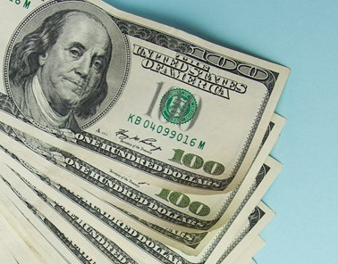
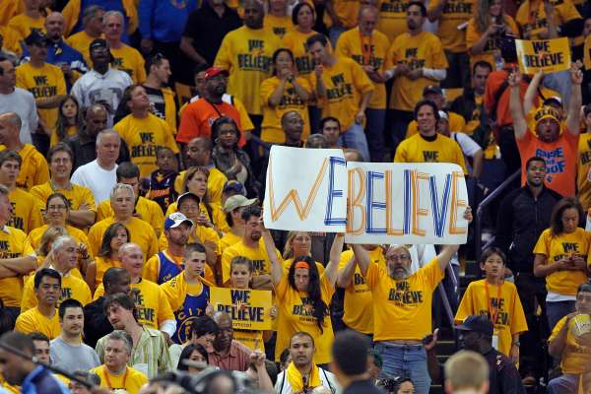
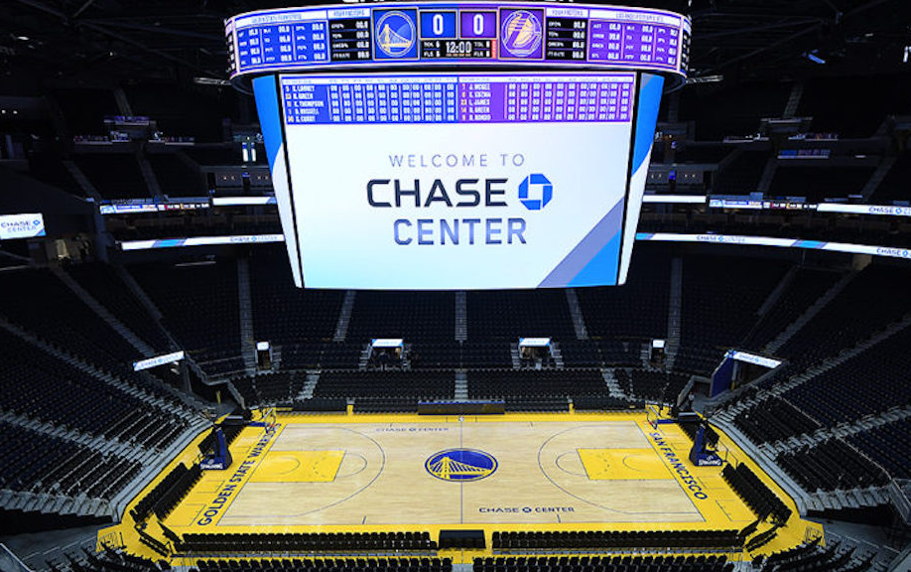
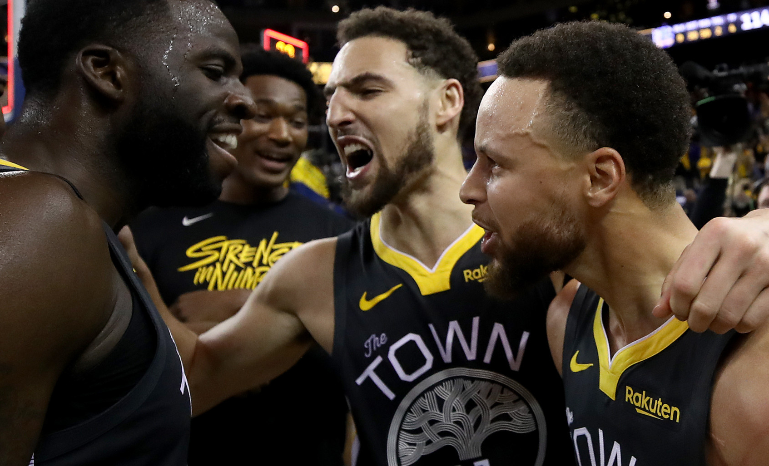
Pulse of the fanbase

Slide 3


NLP Processing
Notes:
Twitter Scraper and Pandas to form corpus – initial cleaning

Slide 4


NLP Processing
Notes:
NLTK – lemmatize and count vectorize
Scikit-learn – NMF and PCA and KMeans

Slide 5

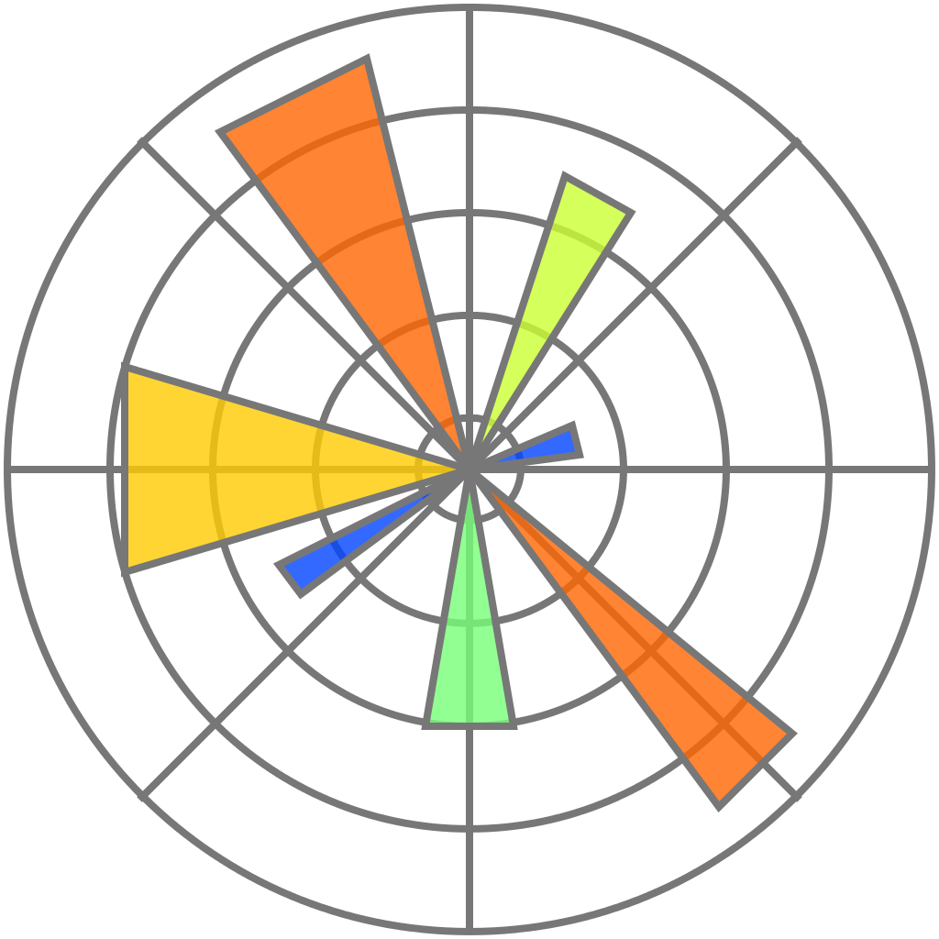
NLP Processing
Notes:
Seaborn/Matplotlib for visualization

Slide 6
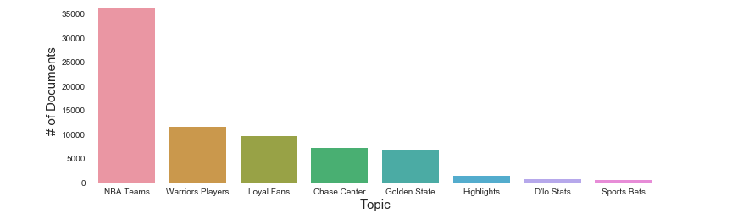
Tweet topics
Notes:
Main topic count
Loyal Fans / Warriors Players

Slide 7
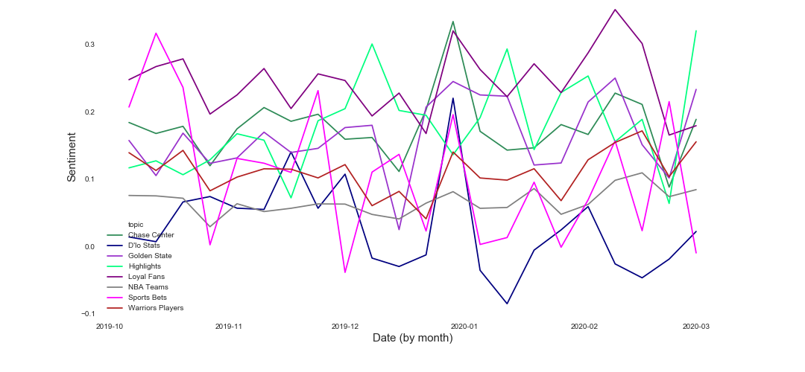
Sentiment over time

Slide 8
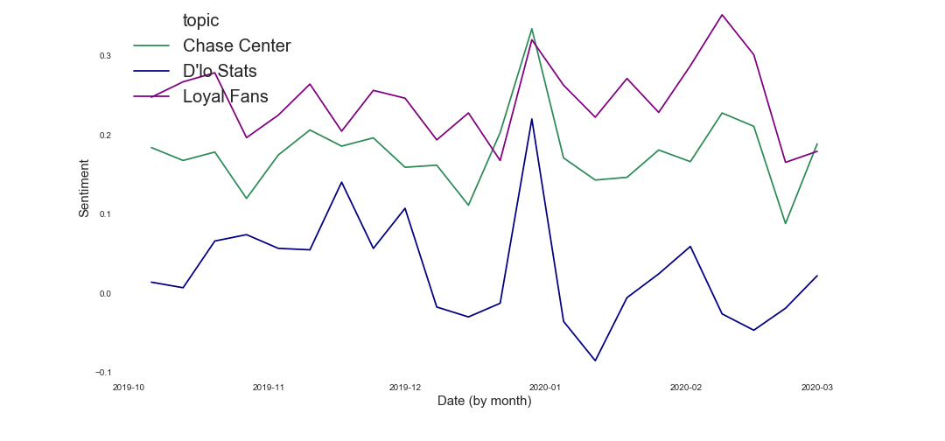
Sentiment parallels

Slide 9
Sentiment parallels

Slide 10
Sentiment parallels

Slide 11
Sentiment parallels

Slide 12
Sentiment parallels

Slide 13
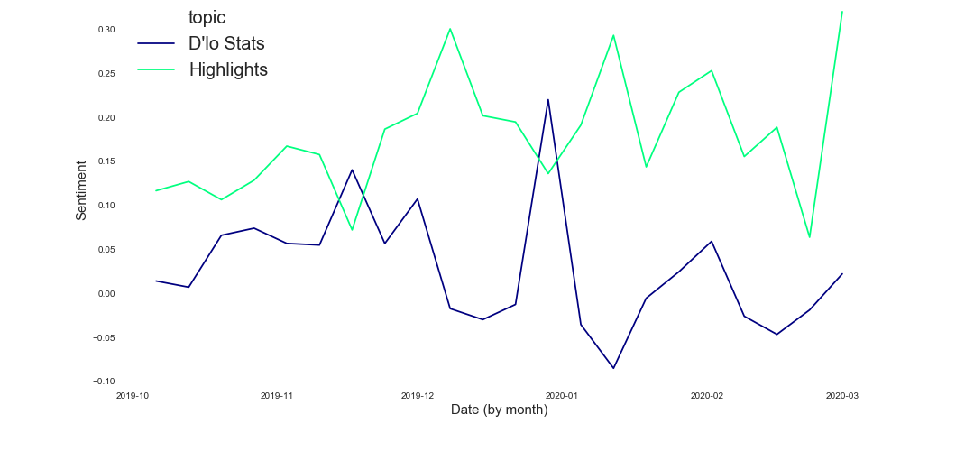
Sentiment contrast

Slide 14

Future work
Dig further into hashtags
Test out a variety of clustering
Flask App
Notes:
DBScan Umap

Slide 15
Thank you!

Slide 16
appendix

Slide 17
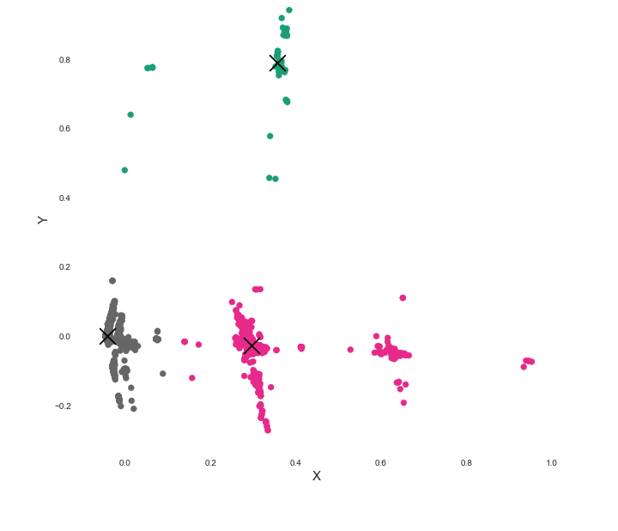
KMEANs clustering

